Slide 1

CleanHome
Convenient Service
Boyi Zhang

Slide 2
Improvements made from feedback
1. Complete user stories with a fixed format
As a… I want… So that…
2. Adding expectation curves to burndown charts
3. Modify Github Wiki-page title

Slide 3
List
Team member
Project Introduction
Problem Statement
Personas
MVP demo
Technology
Diagram
Backlog
Summary

Slide 4
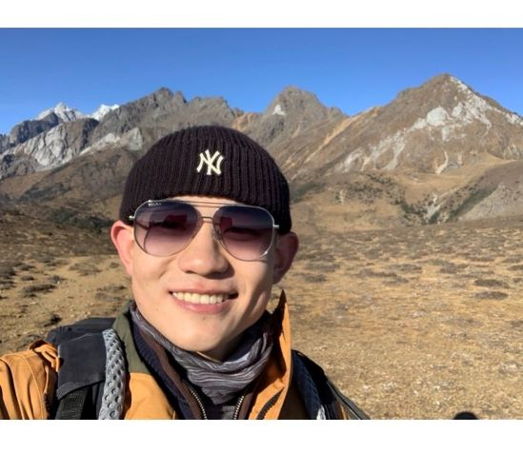
OUR TEAM
Responsible
product design
UI design
Implement project code
Collect user feedback
Ensure that the project meets user needs
Boyi Zhang
Product manager

Slide 5
INTRODUCTION
Cleanhome. As a convenient service platform, Cleanhome provides a one-stop housekeeping service for people's daily life, including cleaning, maintenance, gardening and other services.

Slide 6
Problem Statement
There are many problems with traditional Housekeeping services, such as difficulties make a appointment and guaranteeing service quality.
Aa one-stop service platform, we can solve most user needs, not just cleaning.

Slide 7
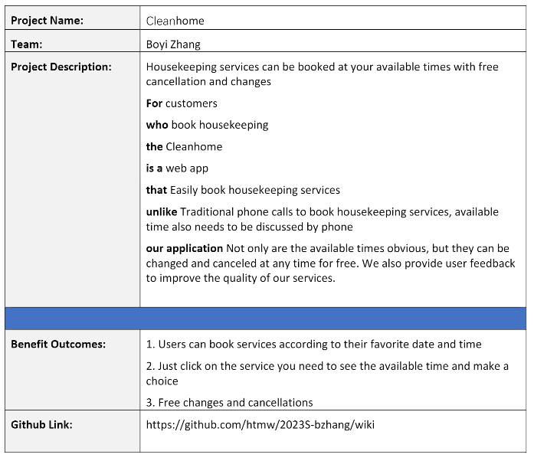
Project Description Summary

Slide 8
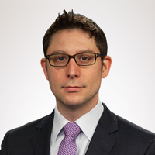
Persona 1
Demographics
Name: Oliver
Age: 35
Location: New York, NY
Job: Stock manager
Salary: $100,000-$120,000/year
Family: living alone
Profile
As an experienced stock manager, Oliver not only has to go to work on time every day, but also prepares for tomorrow's trading after get off work. Because of his work, he always likes to dress professionally and has a lot of suits at home.
Frustration
· He has a big apartment and doesn't have time to clean it.
· No time to take the suit to dry cleaning
Goals
· Need cleaning service
· Need to take the suit to dry cleaning

Slide 9

Persona 2
Demographics
Name: Anna
Age: 32
Location: New Jersey, NY
Job: Full time housewife
Salary: $0/year
Family: Lives with her husband and has three children
Profile
She lives in a house with his family. Every day, she cooks for her three children and her husband and cleans the house. Occasionally the yard needs to be cleaned.
Frustration
· The house is too big, it's tiring to clean it every time.
· When cleaning the garden, the tools are too heavy for her to clean
· Cleaning takes too much time every time and needs some time to do her own interests
Goals
· Cleaning services are needed to clean part of the home
· Need to clean the weeds and water the garden

Slide 10
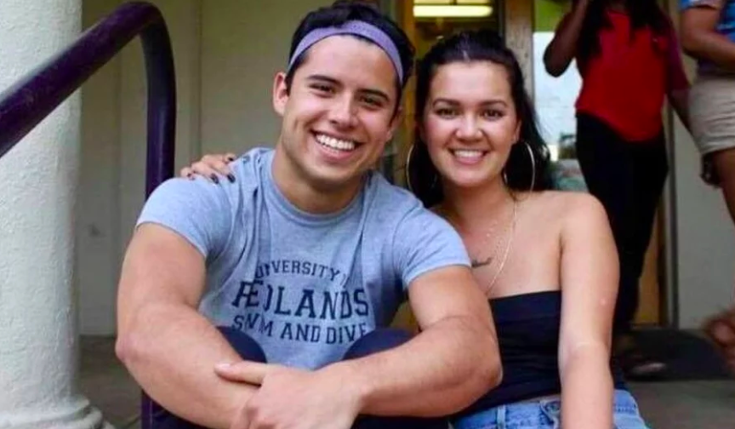
Persona 3
Demographics
Name: Frank
Age: 25
Location: New York, NY
Job: Bank employee
Salary: $48,000-$60,000/year
Family: Lives with his girlfriend and a dog
Profile
As a fresh graduate, he needs to go to the bank to work on time every day. But sometimes because of work, it is necessary to exchange to a bank in another place. Her girlfriend is studying at NYU. He and his girlfriend live in a rented house in New York. They have a dog together.
Frustration
· Moving and cleaning is too tiring, he doesn't want to do it himself
Goals
· Need cleaning service after they move
· Clean the newly rented apartment

Slide 11
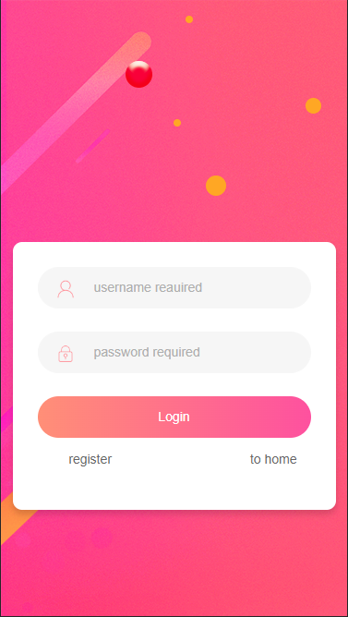
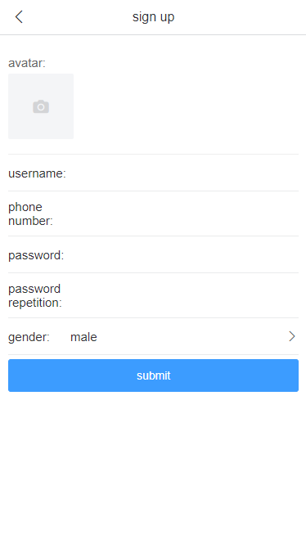
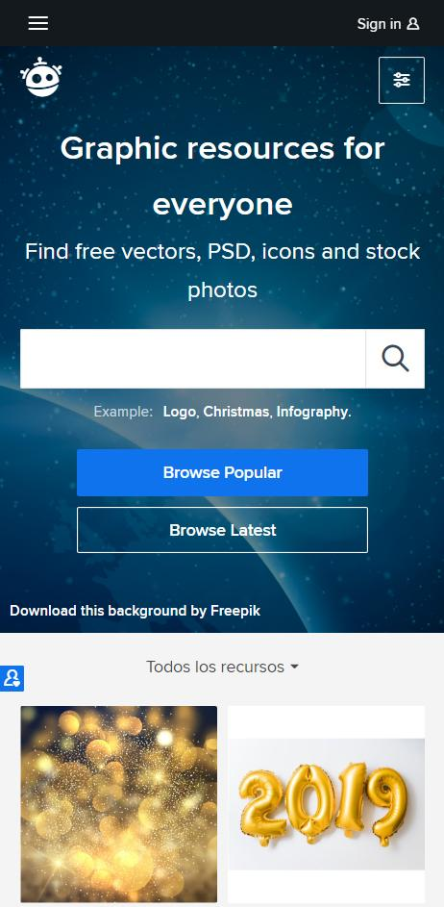
MVP DEMO
Login page
Signup page

Slide 12
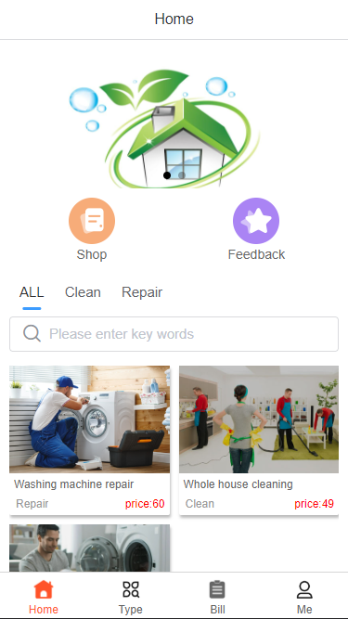
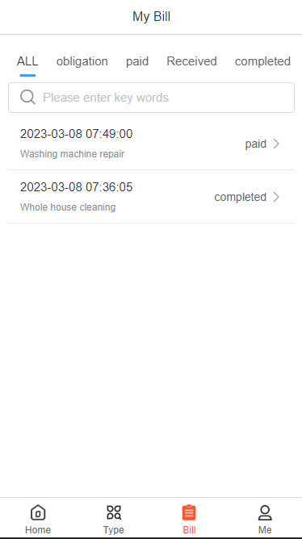
MVP DEMO
Home page
Order page

Slide 13
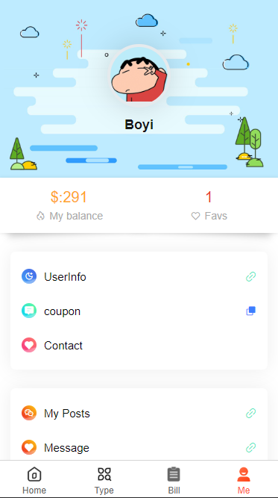
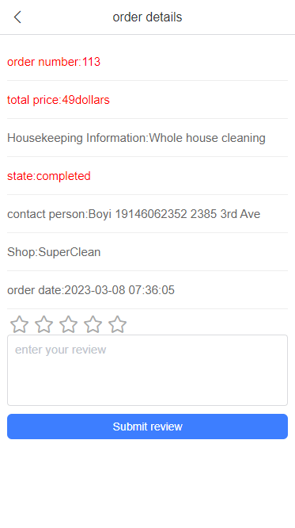
MVP DEMO
Profile page
Feedback page

Slide 14

Technology Tools

Slide 15
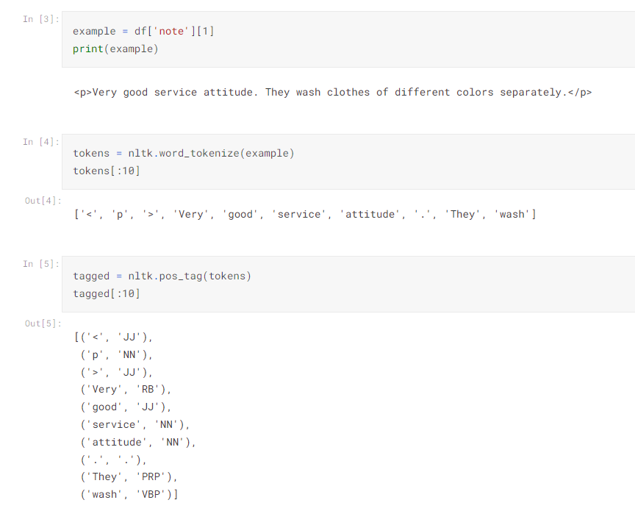
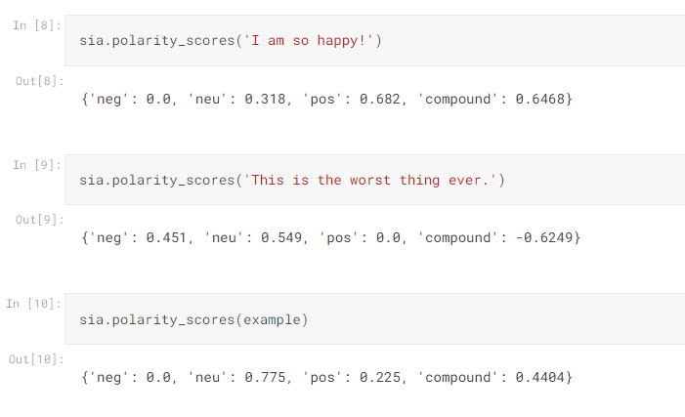
ML-NLTK (Natural Language Toolkit)

Slide 16
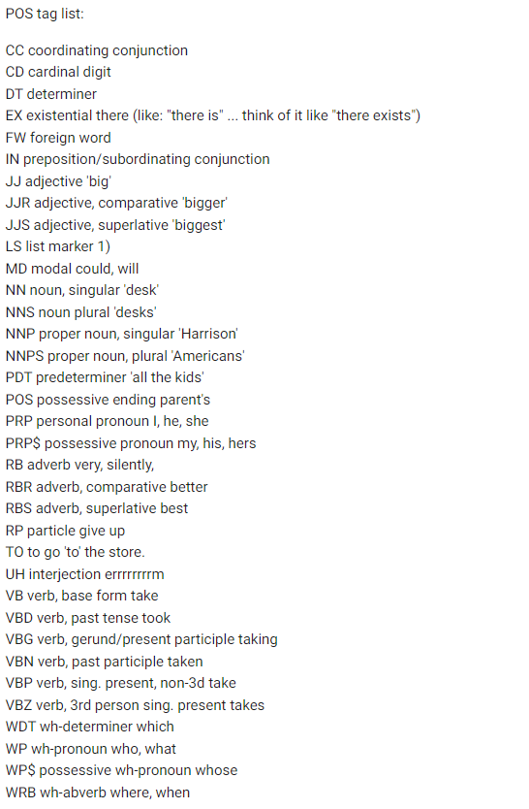
ML-NLTK (Natural Language Toolkit)

Slide 17
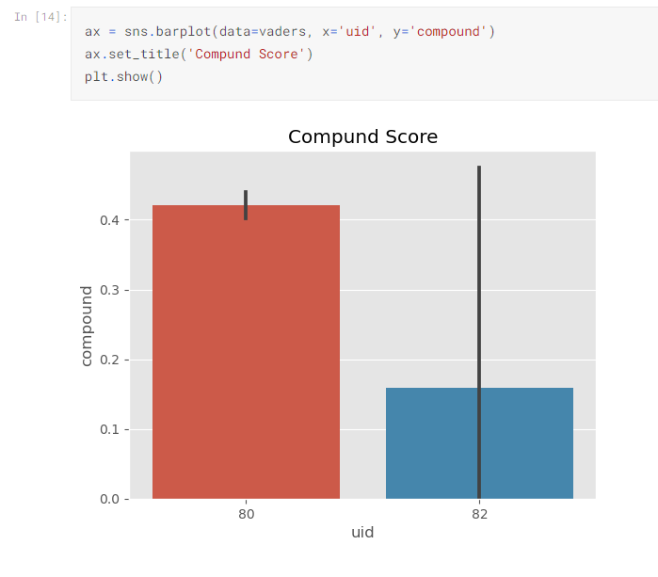
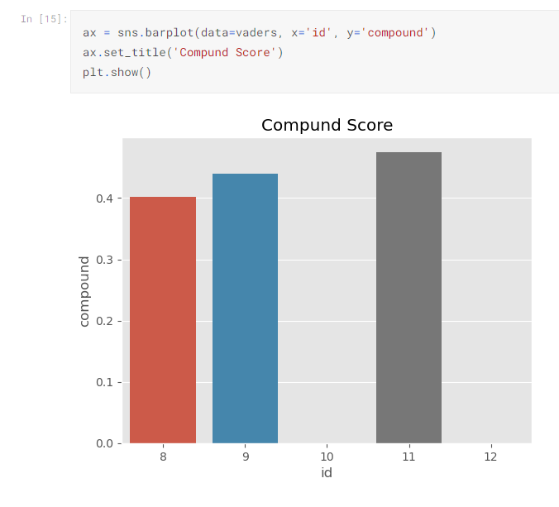
ML-NLTK (Natural Language Toolkit)

Slide 18
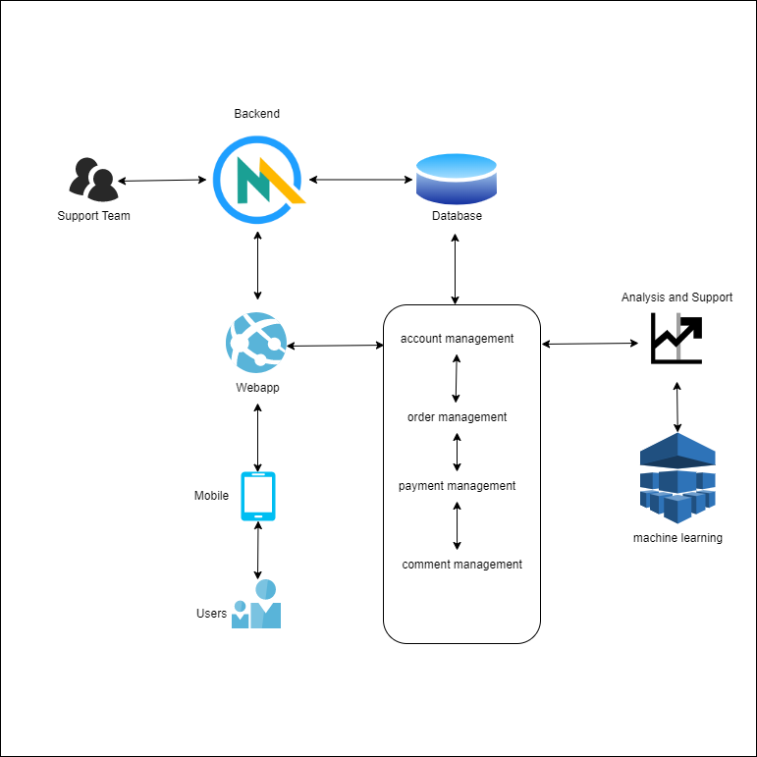
Conceptual Diagram

Slide 19
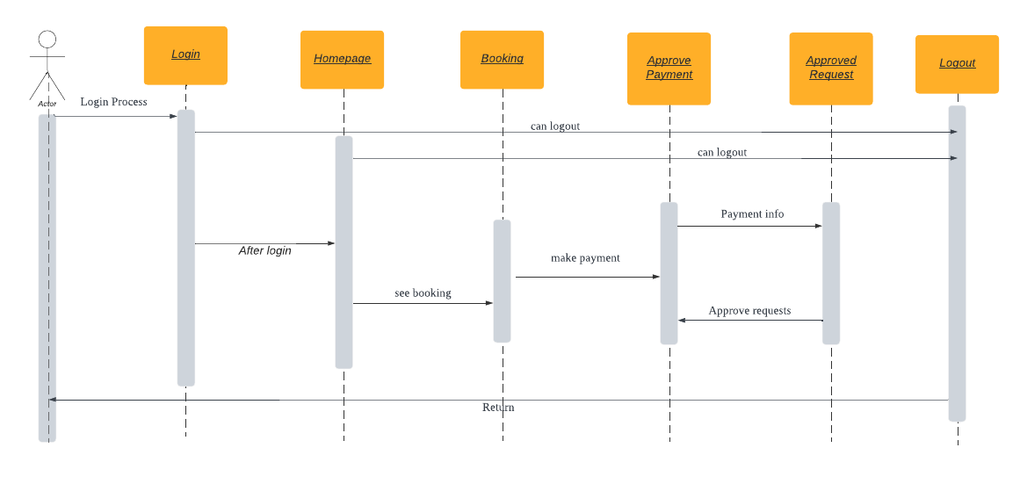
Sequence Diagram

Slide 20
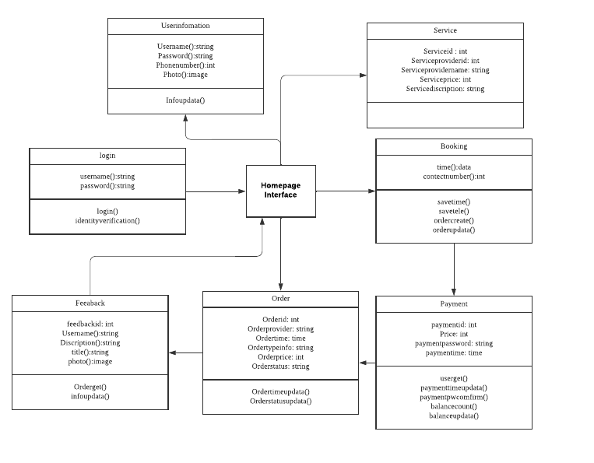
Class Diagram

Slide 21
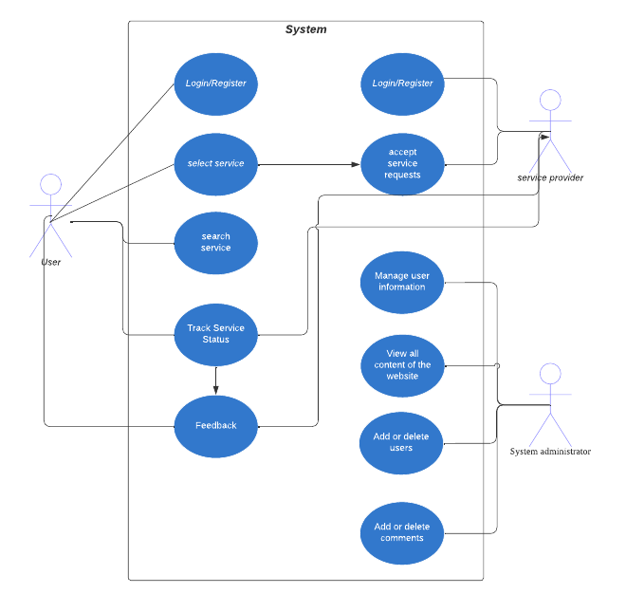
Use Case Diagram

Slide 22
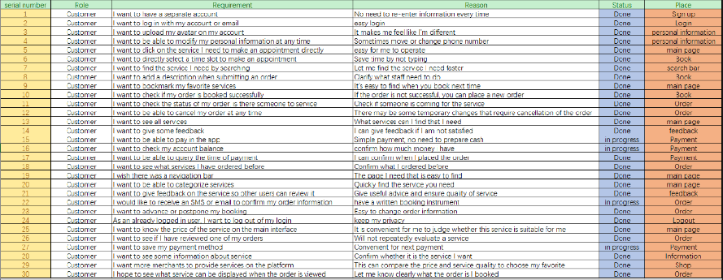
Sprint 1 Recap

Slide 23
Sprint 2 backlog

Slide 24
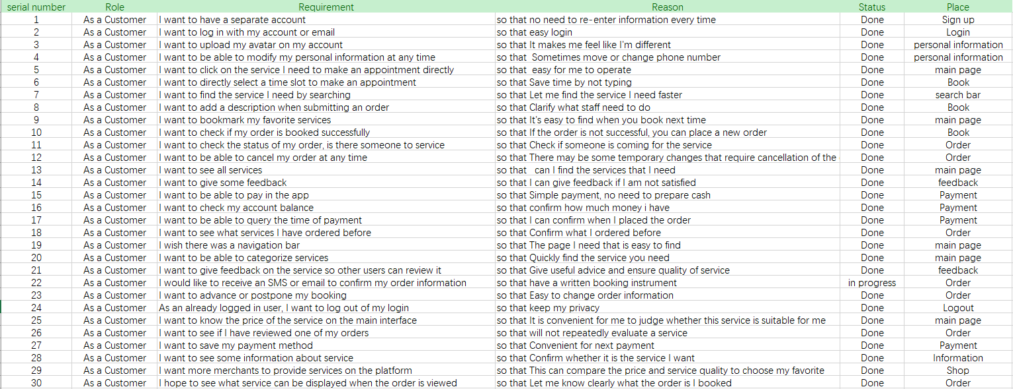
User Stories

Slide 25
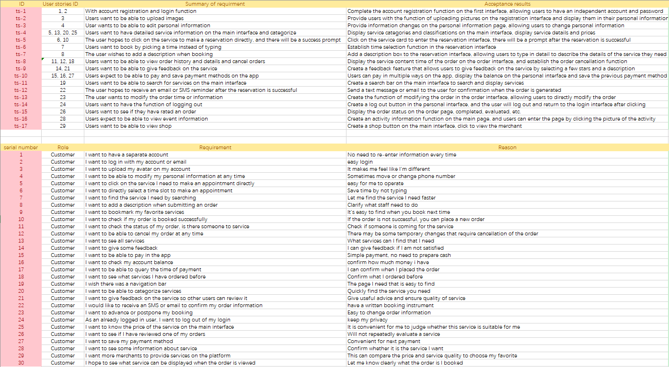
Acceptance Criteria

Slide 26
Test Case

Slide 28
Sprint 2 Burndown Charts

Slide 29
Program Completion
Total: 24
Complete: 23
Undone: 1
task completion: 96%
96%
Complete
4%
Undone

Slide 30
What went well?
Completed most of the mission plans
Followed the rules of agile programming
User Review Analysis with Machine Learning

Slide 31
what need to improved?
Add more user data
Add more comments to improve the code
Find a standard format to write the required documents

Slide 32
App screenshots

Slide 33
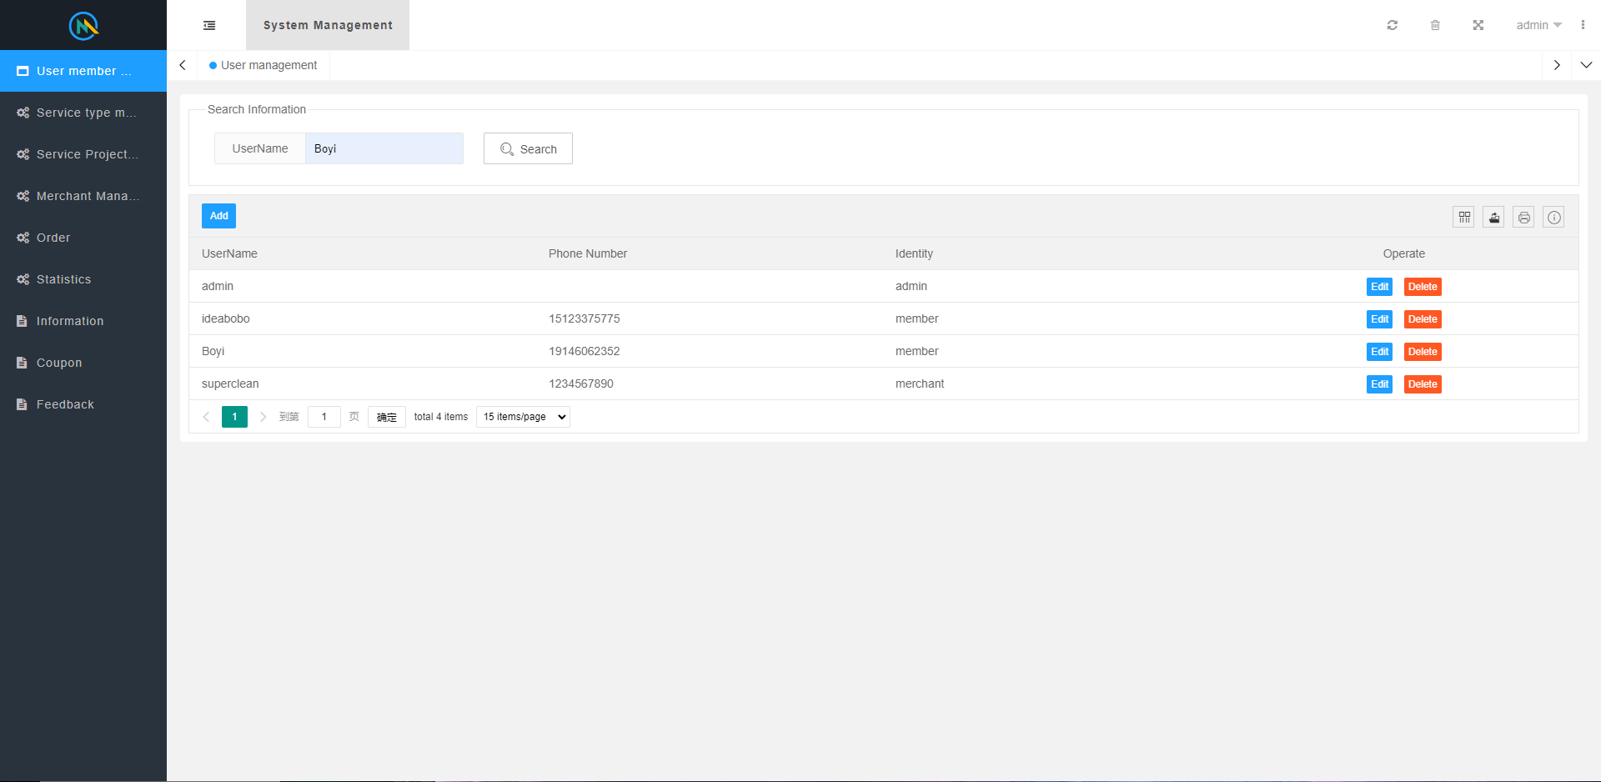
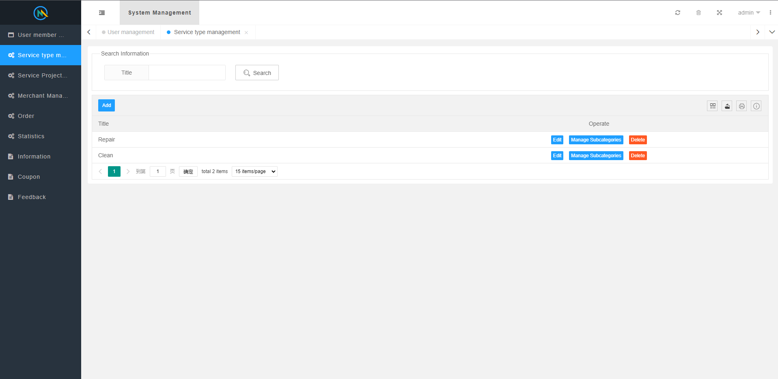
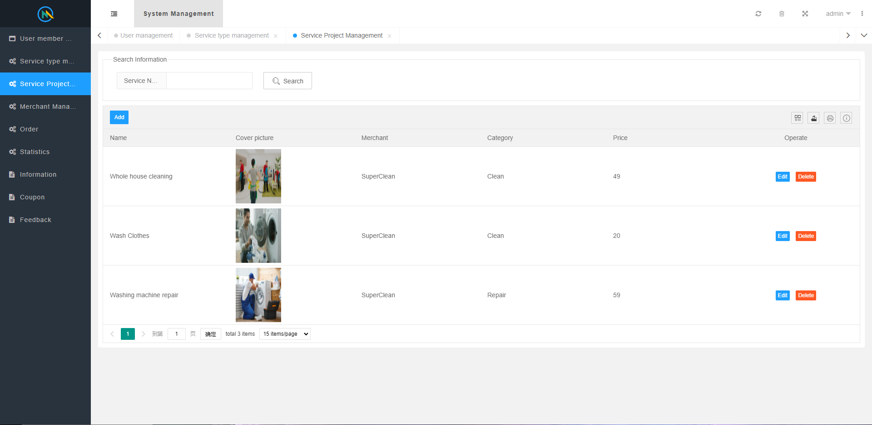
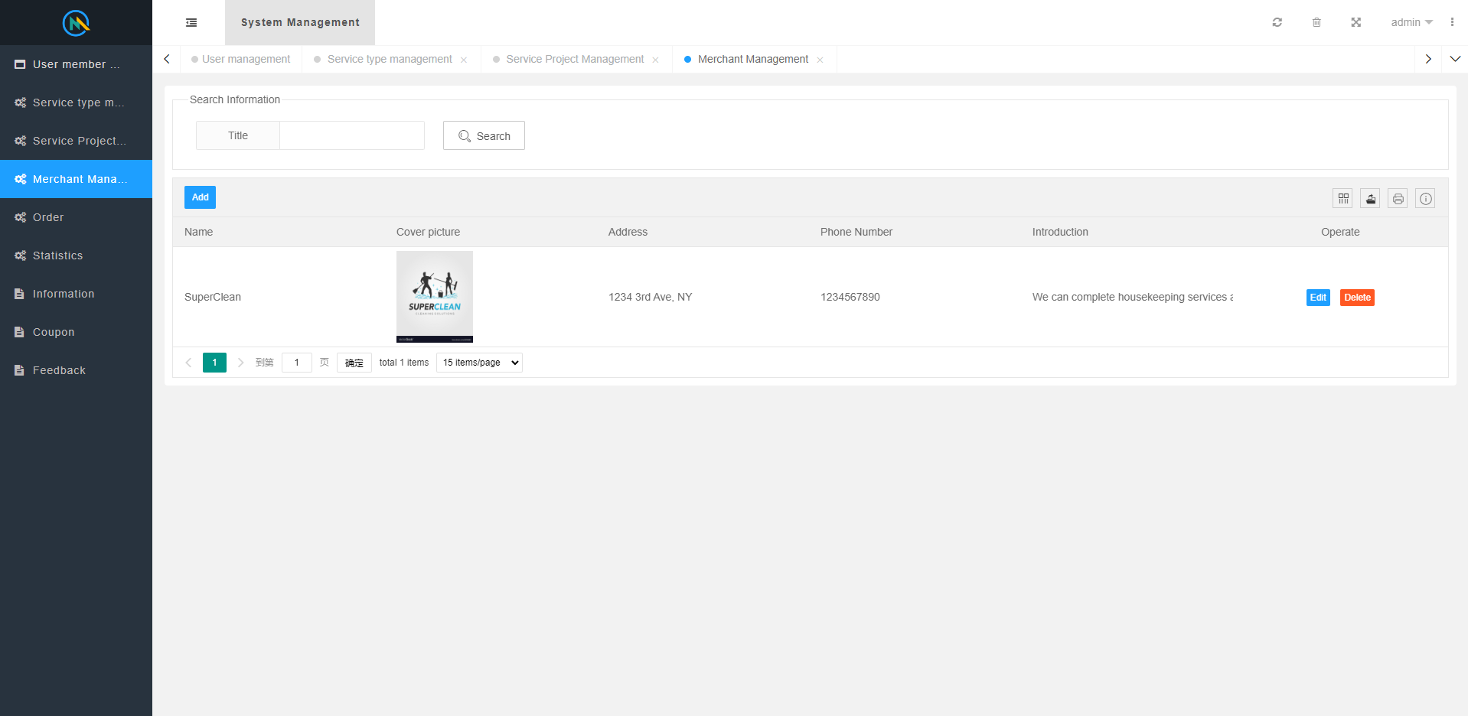
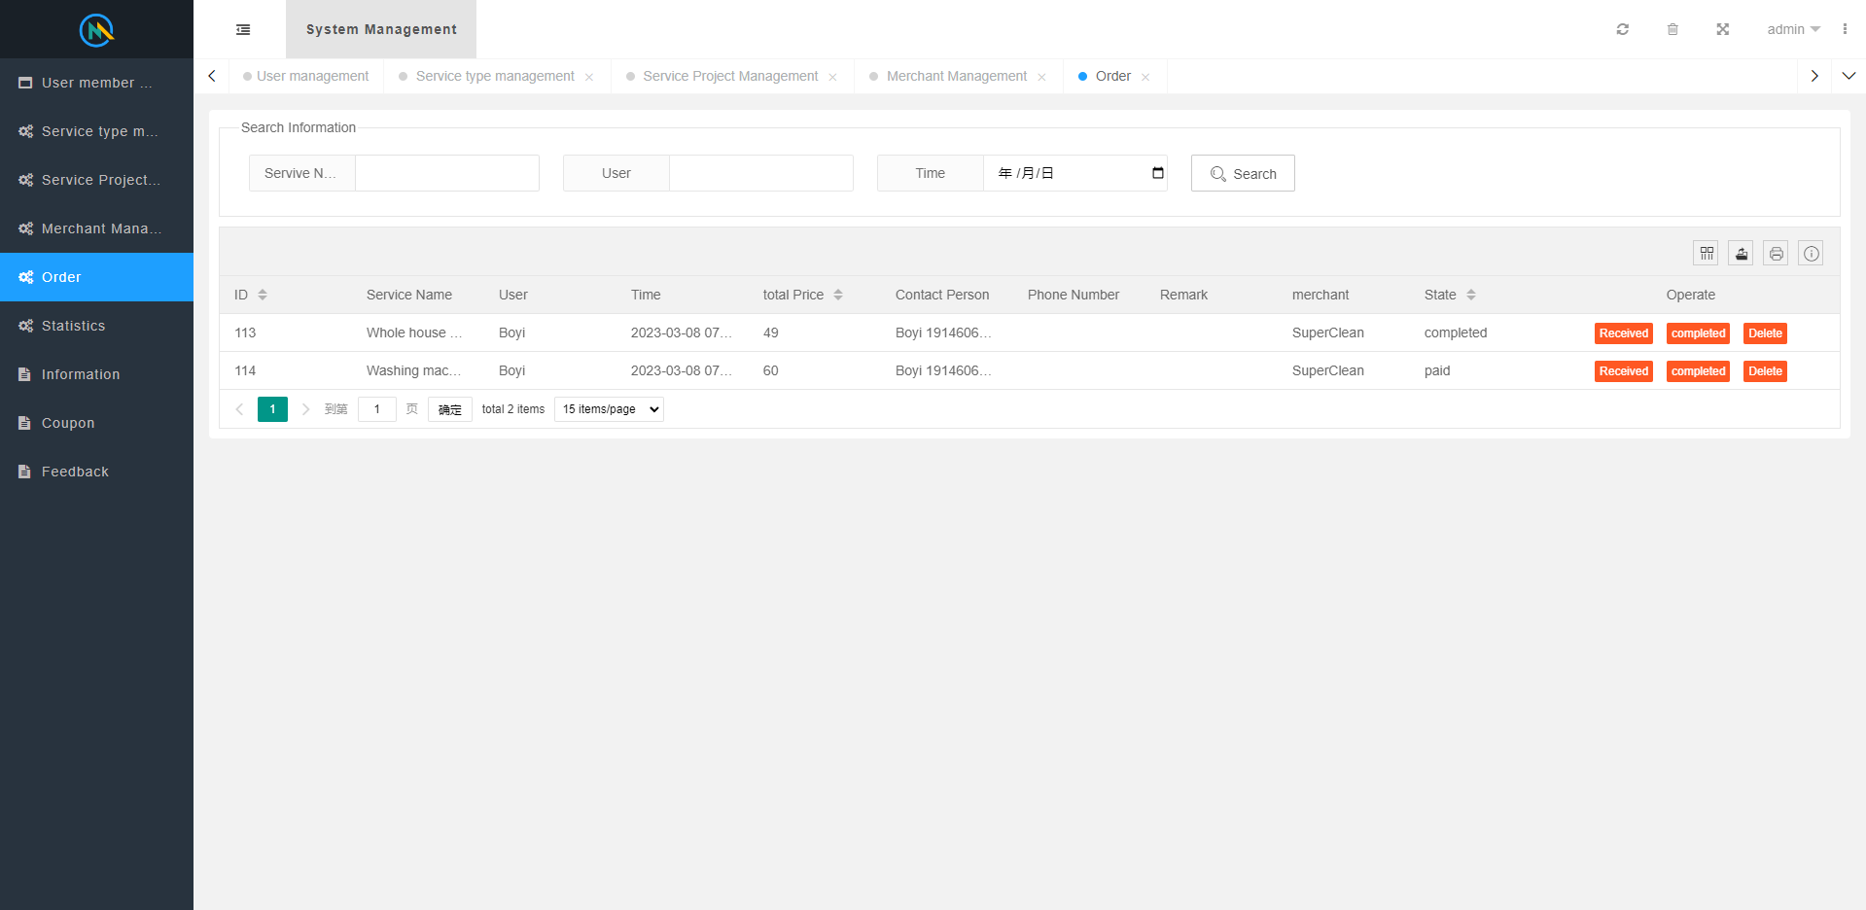
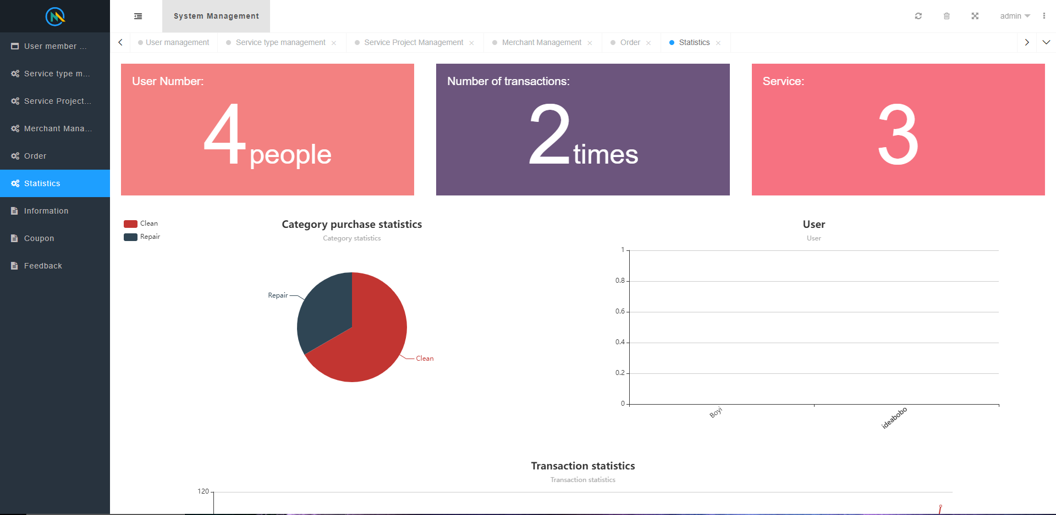
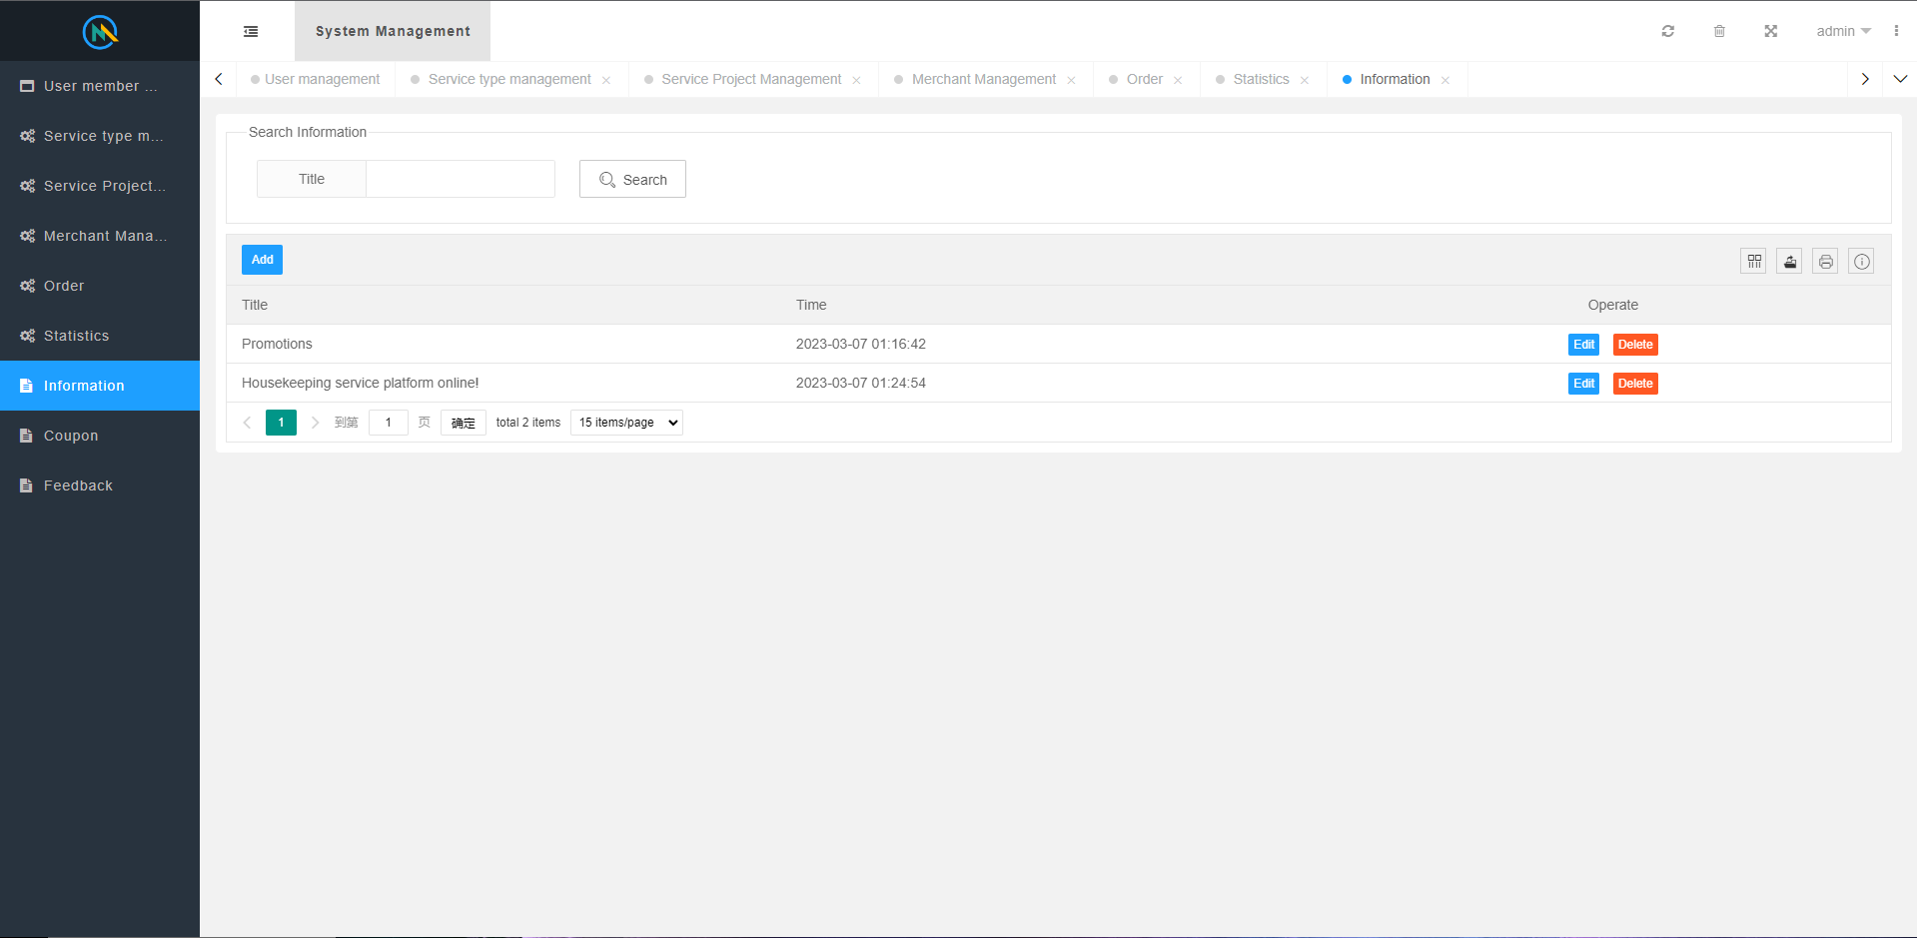
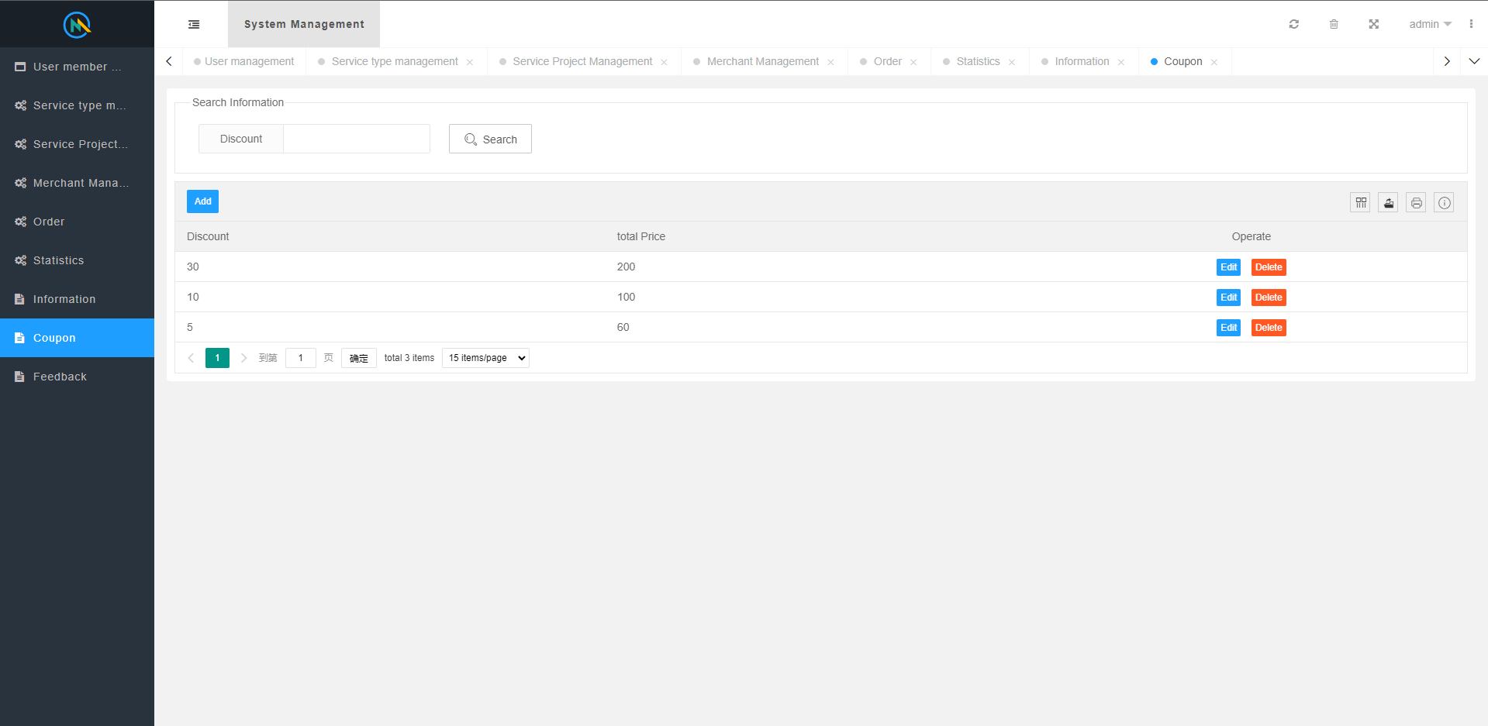
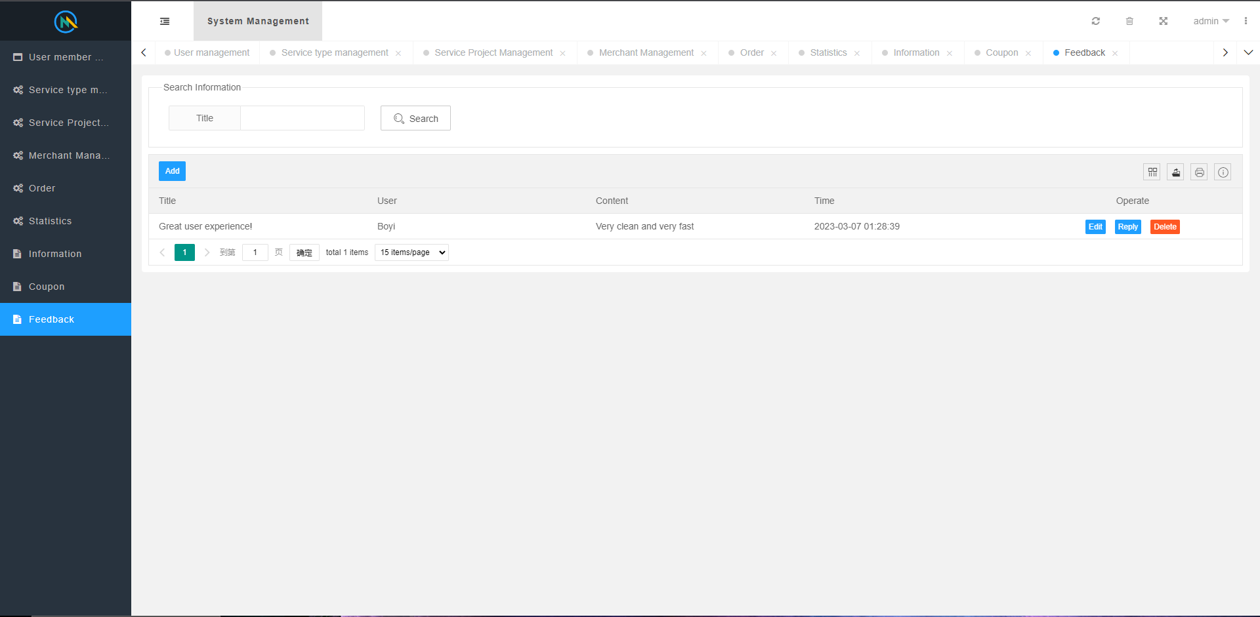
API screenshots

Slide 34
Link
Github: https://github.com/htmw/2023S-bzhang/wiki
Final Demo video: https://youtu.be/9dv85Yx7eYc

